Slide 1


Slide 2
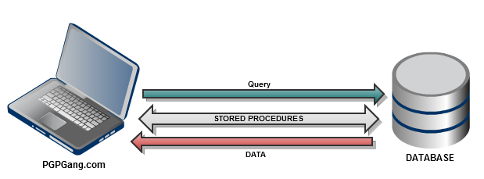
Stored Procedures

Slide 3
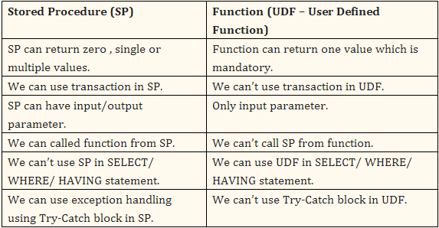
Stored Procedures VS Functions

Slide 4
Create a Stored Procedure
CREATE [DEFINER = { user | CURRENT_USER }] PROCEDURE sp_name
([proc_parameter[,...]])
routine_body
DELIMITER $$
DROP PROCEDURE IF EXISTS hello$$
CREATE PROCEDURE hello
(IN mi_nombre VARCHAR(60))
BEGIN
SELECT CONCAT(‘hello ‘, mi_nombre) AS greeting;
END$$
DELIMITER ;
proc_parameter: [ IN | OUT | INOUT ] param_name type
type: Any valid MySQL data type
routine_body:
Valid SQL routine statement

Slide 5
User and Procedure Variables
User variables
Set @a = ‘world’;
SELECT @a,(@a:=20), @a;
Procedure Variables
DECLARE b VARCHAR(60) DEFAULT ‘hello’;
Set b = ‘hola’;
SELECT b;

Slide 6
Obtain Information from a Stored Routines
DELIMITER $$
DROP PROCEDURE IF EXISTS sum_two_numbers$$
CREATE PROCEDURE sum_two_numbers
(IN val1 INT, IN val2 INT, OUT outcome INT)
BEGIN
SET outcome = val1 + val2;
END $$
DELIMITER ;
CALL sum_two_numbers(1,2,@outcome);
SELECT @outcome;

Slide 7
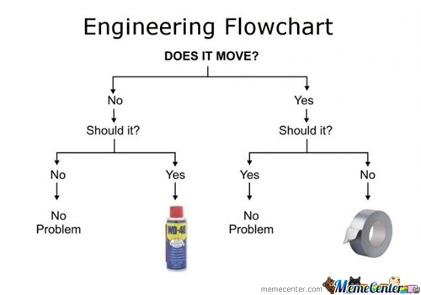
Flow Control Statements

Slide 8
IF , ELSEIF, ELSE
DELIMITER $$
DROP PROCEDURE IF EXISTS if_statement$$
CREATE PROCEDURE if_statement
(IN variable INT)
BEGIN
IF variable > 10 THEN
SELECT 'SOY MAYOR A 10';
ELSEIF variable < 10 THEN
SELECT 'SOY MENOR A 10';
ELSE
SELECT 'SOY IGUAL A 10';
END IF;
END $$
DELIMITER ;
CALL if_statement(10);
IF search_condition THEN statement_list
[ELSEIF search_condition THEN statement_list]
...
[ELSE statement_list]
END IF

Slide 9
CASE
DELIMITER $$
DROP PROCEDURE IF EXISTS case_statement$$
CREATE PROCEDURE case_statement
(IN variable INT)
BEGIN
CASE variable
WHEN ‘1’ THEN
SELECT ‘SOY UN 1’;
SELECT ‘BIEN =D’;
WHEN ‘0’ THEN
SELECT ‘SOY UN 0’;
SELECT ‘MAL D=’;
ELSE
BEGIN
SELECT CONCAT_WS(‘ ’,variable,‘ ESA OPCIÓN NO LA TENGO’);
END;
END CASE;
END $$
DELIMITER ;
CALL case_statement(1);
CASE case_value
WHEN when_value THEN statement_list
[WHEN when_value THEN statement_list]
...
[ELSE statement_list]
END CASE
CASE
WHEN search_condition THEN statement_list
[WHEN search_condition THEN statement_list]
...
[ELSE statement_list]
END CASE
REALIZAR EL PROCEDURE if_statement UTILIZANDO LA SEGUNDA OPCIÓN DEL CASE

Slide 10
LOOP, ITERATE, LEAVE
DELIMITER $$
DROP PROCEDURE IF EXISTS doiterate$$
CREATE PROCEDURE doiterate
(IN p1 INT, OUT p2 INT)
BEGIN
label1: LOOP
SET p1 = p1 + 1;
IF p1 < 10 THEN
ITERATE label1;
END IF;
LEAVE label1;
END LOOP label1;
SET p2 = p1;
END$$
DELIMITER ;
DELIMITER $$
DROP PROCEDURE IF EXISTS doiterate$$
CREATE PROCEDURE doiterate
(IN p1 INT, OUT p2 INT)
BEGIN
label1: LOOP
SET p1 = p1 + 1;
IF p1 >=10 THEN
LEAVE label1;
END IF;
END LOOP label1;
SET p2 = p1;
END$$
DELIMITER ;
[begin_label:] LOOP
statement_list
END LOOP [end_label]

Slide 11
REPEAT, WHILE
DELIMITER $$
DROP PROCEDURE IF EXISTS dorepeat$$
CREATE PROCEDURE dorepeat(INOUT p1 INT)
BEGIN
SET @x = 0;
REPEAT
SET @x = @x + 1;
UNTIL @x > p1
END REPEAT;
SET p1 = @x;
END $$
DELIMITER ;
SET @a = 10;
CALL dorepeat(@a);
SELECT @a,@x;
[begin_label:] WHILE search_condition DO
statement_list
END WHILE [end_label]
[begin_label:] REPEAT
statement_list
UNTIL search_condition
END REPEAT [end_label]
DELIMITER $$
DROP PROCEDURE IF EXISTS dowhile$$
CREATE PROCEDURE dowhile()
BEGIN
DECLARE v1 INT DEFAULT 5;
WHILE v1 > 0 DO
SET v1 = v1 - 1;
SELECT v1;
END WHILE;
END $$
DELIMITER ;
CALL dowhile();

Slide 12
Transactions and DDL (Data Definition Language)
DELIMITER $$
DROP PROCEDURE IF EXISTS trans$$
CREATE PROCEDURE trans()
BEGIN
SET autocommit=0;
START TRANSACTION;
INSERT INTO employee (name, last_name) VALUES ('JUAN','LOZANO');
COMMIT;
SET autocommit=1;
END;
DELIMITER $$
DROP PROCEDURE IF EXISTS new_table$$
CREATE PROCEDURE new_table()
BEGIN
CREATE TABLE my_type(
id int
);
END;

Slide 13
Dynamic SQL
DELIMITER $$
DROP PROCEDURE IF EXISTS dyn$$
CREATE PROCEDURE dyn
(IN tbl VARCHAR(64), IN col VARCHAR(64))
BEGIN
SET @s = CONCAT('SELECT ',col,' FROM ',tbl );
PREPARE stmt FROM @s;
EXECUTE stmt;
DEALLOCATE PREPARE stmt;
END;
CALL dyn('employee','name');

